Slide 1
MongoDB Architecture

Slide 2
Overview
Document oriented, not table/row oriented
Collection of binary JSON (BSON) documents
Schemaless
No relations or transactions native in database
Scalable and high-performance
Full index support
Written in C++
Servers for all major platforms
Drivers for all major development environments
Free and open-source, but also commercial support

Slide 3
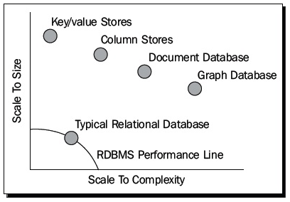
Use cases
High performance and scalable applications
Most web applications where you would previously use SQL
Do not use for:
Transaction-critical applications

Slide 4
BSON
Binary JSON
Binary encoded serialization of JSON-like documents
Like JSON, BSON supports the embedding of documents and arrays within other documents and arrays. BSON also contains extensions that allow representation of data types that are not part of the JSON spec. For example, BSON has a Date type and a BinData type.
The driver performs translation from the language’s “domain object” data representation to BSON, and back

Slide 5
Embedding documents
Nesting of objects and arrays inside a BSON document
For a “contains” type of relationship
Retrieve entire document with one call
{ _id: ObjectId(‘12345‘),
author: 'joe',
created : new Date('03/28/2009'),
title : 'Yet another blog post',
text : 'Here is the text...',
tags : [ 'example', 'joe' ],
comments : [ { author: 'jim', comment: 'I disagree' },
{ author: 'nancy', comment: 'Good post' }
]
}

Slide 6
Linking documents
“application-level relations”
Where embedding would cause duplication of data
{ _id: ObjectId(‘12345‘),
author: 'joe',
created : new Date('03/28/2009'),
title : 'Yet another blog post',
text : 'Here is the text...',
tags : [ 'example', 'joe‘ ]
}
{ author: 'jim',
post_id: ObjectId(‘12345‘),
comment: 'I disagree‘
}
{ author: 'nancy',
post_id: ObjectId(‘12345‘),
comment: 'Good post'
}

Slide 7
Querying
Queries return a cursor, which can be iterated to retrieve results
Query optimizer executes new plans in parallel
Queries are expressed as BSON documents which indicate a query pattern
db.users.find({'last_name': 'Smith'})
// retrieve ssn field for documents where last_name == 'Smith':
db.users.find({last_name: 'Smith'}, {'ssn': 1});
// retrieve all fields *except* the thumbnail field, for all documents:
db.users.find({}, {thumbnail:0});
// retrieve all users order by last_name:
db.users.find({}).sort({last_name: 1});
// skip and limit:
db.users.find().skip(20).limit(10);

Slide 8
Advanced querying
{ name: "Joe", address: { city: "San Francisco", state: "CA" } , likes: [ 'scuba', 'math', 'literature' ] }
// field in sub-document:
db.persons.find( { "address.state" : "CA" } )
// find in array:
db.persons.find( { likes : "math" } )
// regular expressions:
db.persons.find( { name : /acme.*corp/i } );
// javascript where clause:
db.persons.find("this.name != 'Joe'");
// check for existence of field:
db.persons.find( { address : { $exists : true } } );
Aggregate queries like group by, count, distinct; only available for single instances

Slide 9
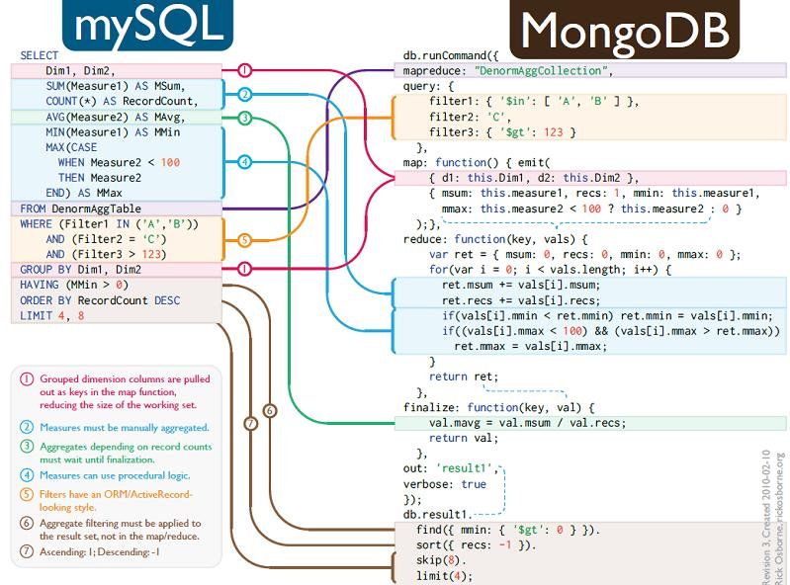
Map/Reduce

Slide 10
Data Model
Stores data in form of BSON (binary JavaScript Object Notation) documents
{
name: “travis”, salary: 30000,
designation: “Computer Scientist”, teams: [ “front-end”, “database” ]
}
Group of related documents with a shared common index is a collection

Slide 11
Query
Query all employee names with salary greater than 18000 sorted in ascending order
db.users.find({salary:{$gt:18000}, {name:1}}).sort({salary:1})
Collection Condition Projection Modifier
{salary:25000, …}
{salary:10000, …}
{salary:20000, …}
{salary:2000, …}
{salary:30000, …}
{salary:21000, …}
{salary:5000, …}
{salary:50000, …}
{salary:25000, …} |  |  | {salary:20000, …}
{salary:20000, …} |  |  | {salary:21000, …}
{salary:30000, …} |  |  | {salary:25000, …}
{salary:21000, …} |  |  | {salary:30000, …}
{salary:50000, …} |  |  | {salary:50000, …}

Slide 12
Insert
Insert a row entry for new employee Sally
db.users.insert({
name: “sally”, salary: 15000, designation: “MTS”,
teams: [ “cluster-management” ]
})

Slide 13
Update
All employees with salary greater than 18000 get a designation of Executive
db.users.update(
{salary:{$gt:18000}},
{$set: {designation: “Manager”}},
{multi: true}
)
Update Criteria Update Action Update Option
Multi option allows multiple document update

Slide 14
Delete
Remove all employees who earn less than 10000
db.users.remove(
{salary:{$lt:10000}},
)
Remove Criteria
Can accept a flag to limit the number of document removal

Slide 15
Indexes
Unique index on primary key (_id field)
Create index from application code (ensureIndex)
Index on embedded documents and fields
Index on array fields (multikey index)
Unique and sparse index
Geospatial index
TTL index
No native full text indexing

Slide 16
Replication
A replica set is a cluster of mongod instances
2-12 instances; one is primary
Writes are directed to primary
Secondary instances replicate from primary asynchronously
Automated failover; when primary fails a secondary will be elected the new primary

Slide 17
Auto-sharding
Partitions data across shards
Any BSON document resides on only one shard
Increases write capacity and total data size
Data automatically distributed
Sharding transparent to application layer
Partitioning based on client-defined shard key
Good shard keys are highly distributed in value and write operations
Sharding requires config servers (minimal 3) to maintain metadata

